Slide 1
Making this resource work for you
Prior to teaching this lesson, please refer to the ‘Unit Overview and Planning Document’.
Further guidance on planning Science Mastery lessons can be found in the detailed planning guidance document.
Refer to the ‘notes’ section on each slide for useful information, including suggested expositions, pedagogical content knowledge, suggested questions, answers and more. Consider using presenter mode so you can see this guidance throughout the lesson.
The introduction slides can be adapted to suit your teaching style and the needs of your class.
Before the lesson, adapt the fix-it slide to address any misconceptions identified in the previous lesson’s exit ticket.
Choose from the suggested activities to suit your class. The intention is not that you complete all of these, but that you select those which ones are most appropriate for your students. It may be appropriate to further adapt activities for your students.
These lessons are designed to occupy approximately 1 hour. To adapt for a shorter or longer lesson duration we advise you to adapt the activity section accordingly.
Please consider using the final slide to send feedback about this lesson or examples of PowerPoints that you have adapted to our design team. Your feedback is used to improve Science Mastery for all of our teachers and students. We appreciate all suggestions and comments.
Thank you for reading!
The Science Mastery Team

Slide 2
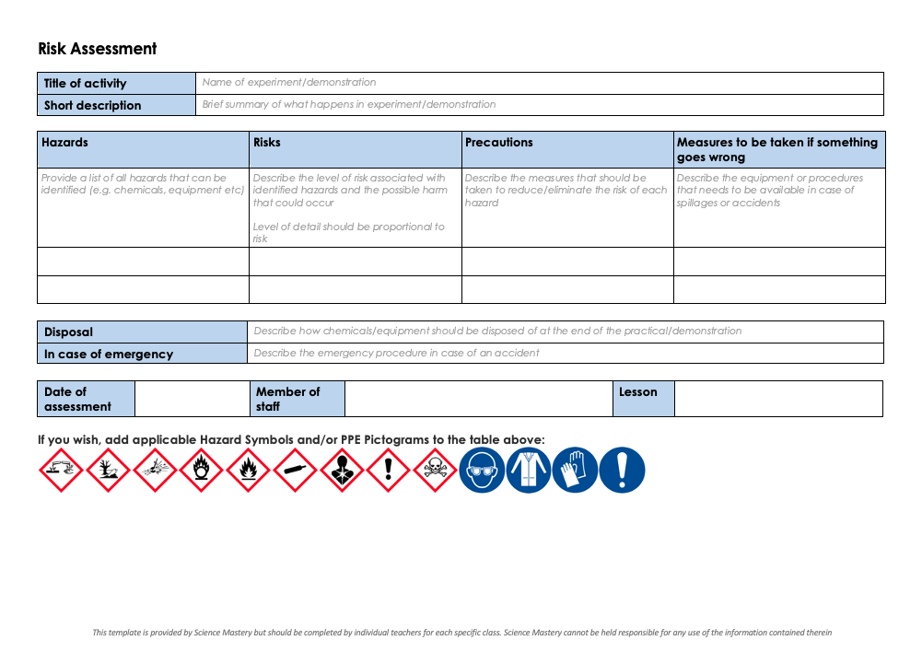
Practical Activity
This lesson contains a practical activity (either a whole class activity or a demonstration)
A risk assessment must be completed for this practical
The template risk assessment can be found here.
The risk assessment should be specific to the class involved and written only by the teaching member of staff
The risk assessment should refer to the current CLEAPSS Hazcards for all chemicals used in the practical for safety and disposal notes.
A list of chemicals used can be found in the Practical Guide
It is good practice for students to wear safety spectacles during all class practicals and demonstrations
Thank you for reading!
The Science Mastery Team

Slide 3

Extracting Metals by Electrolysis
Answer the questions below.
What happens to metal atoms, that causes them to form positive ions?
What is another name for positive ions?
Write the electronic configuration of a sodium atom.
Write the electronic configuration of a sodium ion.
Which electrode will attract positive ions in an electrolysis set-up?
Metal atoms lose electrons to form positive ions
Another name for a positive ion is a ‘cation’
2, 8, 1
[2, 8]⁺¹
The cathode will attract the positive ions in an electrolysis set-up. (the cations are attracted to the cathode)
Notes:
Big idea: Reactions Rearrange Matter
Foundation: Define ‘electrolysis’
Stretch: Explain why electrolysis cannot be carried out with solid ionic substances
Answers:
Foundation: Electrolysis is the process by which ionic substances are decomposed into simpler substances when an electric current is passed through them
Stretch: For electrolysis to work, the ions must be free to move, which is only possible when an ionic substance is dissolved in water or melted.

Slide 4
Extracting Metals by Electrolysis
Do Now:
What happens to metal atoms, that causes them to form positive ions?
What is another name for positive ions?
Write the electronic configuration of a sodium atom.
Write the electronic configuration of a sodium ion.
Which electrode will attract positive ions in an electrolysis set-up?
Drill:
Define ‘electrolysis’.
Explain why electrolysis cannot be carried out with solid ionic substances.
Notes:
Answers:
Do Now:
1. Metal atoms lose electrons to form positive ions
2. Another name for a positive ion is a ‘cation’
3. 2, 8, 1
4. [2, 8]⁺¹
5. The cathode will attract the positive ions in an electrolysis set-up. (the cations are attracted to the cathode)
Drill:
Electrolysis is the process by which ionic substances are decomposed into simpler substances when an electric current is passed through them
For electrolysis to work, the ions must be free to move, which is only possible when an ionic substance is dissolved in water or melted.

Slide 5
Extracting Metals by Electrolysis
Read Now:
The extraction of minerals, metals and fuels from the Earth has been happening for thousands of years, and humans are doing more and more of it each year. The average person in the UK uses roughly 26 tonnes of raw materials each year. That is the equivalent of the weight of four and a half elephants worth! All of these mines are putting pressure on the natural world. Active mines all over the world cover an area that is about five times the size of Wales. If we were to suddenly stop mining, there would be an energy crisis for many countries, especially those that depend on coal for electricity. 35% of the world still rely on coal for this purpose. In Europe, we would be affected slightly less as we only depend on coal for 15% of our electricity supply.
What mass of raw materials from mines does the average person in the UK use each year?
Give one reason why we cannot suddenly stop mining, even though it is putting pressure on the natural world?
What percentage of electricity in Europe is generated using coal?
Define the words in bold.
Notes:
Answers:
The average person in the UK uses about 26 tonnes of raw materials each year
We cannot suddenly stop mining because this would create an energy crisis for countries that depend on coal for energy
15% of the energy in Europe is generated using coal
equivalent = equal, active = working at the moment, on-going

Slide 6

C4.2.8
14/03/2024
Extracting Metals by Electrolysis
C4.2.1 PKR: Reactions of Metals
C4.2.2 Extracting Less Reactive Metals
C4.2.3 PKR: Ions, Ionic Bonding and Deducing Ionic Formulae
C4.2.4 (HT) Ionic Equations and Displacement Reactions
C4.2.5 (HT) Writing Half Equations
C4.2.6 (HT) Ionic Equations for the Reactions of Acids and Metals
C4.2.7 Introduction to Electrolysis
C4.2.8 Extracting Metals by Electrolysis
C4.2.9 Electrolysis of Molten Ionic Compounds
C4.2.10 Electrolysis in Solutions
C4.2.11RP: Electrolysis of Aqueous Solutions 1
C4.1.12 RP: Electrolysis of Aqueous Solutions 2
C4.1.13 TIF: Corrosion and its Prevention
C4.2.14 (HT) Obtaining Raw Materials
C4.2.15 Recycling Metals
C4.2.16 Feedback Lesson
Notes:
Big Idea: Reactions Rearrange Matter

Slide 7

Following this lesson, students will be able to:
Recall that metals can be extracted from molten compounds by electrolysis
Describe a disadvantage of extraction of metals by electrolysis
Describe how electrolysis is used to extract aluminium from its ore
Key Words:
molten
extraction
cryolite
Notes:
Guidance:
See unit overview document and planning guidance to see how these objectives are typically assessed at GCSE, including examples of what students should be able to do following this lesson.
Planning for different needs:
The learning objectives given on this slide are suggested based on the most common requirements for exams, however they can be adapted based on the needs of different classes.
For best practice, the unit preparation booklet should be used to determine the appropriate focus of lessons within the unit.
While it is not possible to explicitly split content into levelled grades, we recommend that lesson objectives can be classified as critical, core or stretch.
Critical: the content or skill is essential for all students to be able to progress.
Core: the content or skill is important for students to progress, but other opportunities may be available to revisit it.
Stretch: the content or skill may not be essential for all students but is important for students aiming for the highest grades.
Key skill: this is a crucial skill being developed in this unit as part of the skill mapping
C4.2.8 Lesson Objectives:
Critical: Recall that metals can be extracted from molten compounds by electrolysis
Critical: Describe a disadvantage of extraction of metals by electrolysis
Critical: Describe how electrolysis is used to extract aluminium from its ore

Slide 8
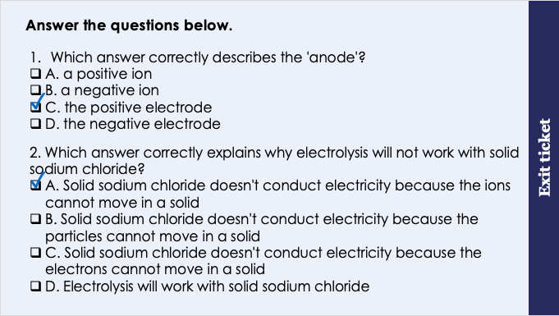
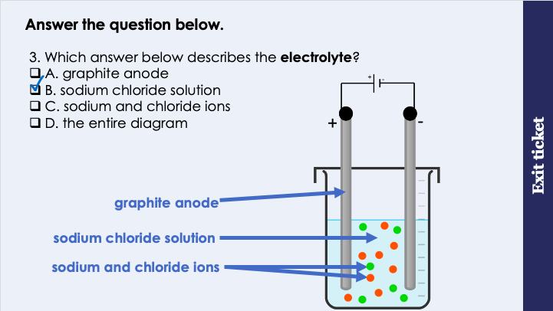
This is the fix-it portion of the lesson
The fix-it is an opportunity to respond to gaps in knowledge, especially those identified by the previous lesson’s exit ticket.
The teacher should customise this slide as needed, to facilitate
reteach, explanation, demonstration or modelling of ideas and concepts that students have not yet grasped or have misunderstood.
practise answering specific questions or of key skills.
redrafting or improving previous work.
Notes:
Fix-it guidance from previous exit ticket:
Q1. Answer: C
If students answer a or b, they are confusing anode and cathode with anion and cation. If students answer D, they are confusing the anode with the cathode. To fix-it, define each of these terms clearly, then annotate an image of an electrolysis set-up with the key words. You may want to use memory tools to help students to recall these words, for example the pneumonic PANIC – ‘Positive Anode, Negative Is Cathode’
Q2. Answer: A
If students answer B or C, they have correctly recalled that solid sodium chloride does not conduct electricity, but they have mixed up (or not been specific enough when using) the words ‘ion’, ‘particle’ and ‘electron’. To fix-it, dual code a diagram of an ionic lattice on the board, labelling the ions within. Explain why ‘ion’ is the best word to use to describe the sodium and chloride ions within.
If students answer D, they have mistakenly thought that electrolysis will work with sodium chloride, perhaps because they think that solid sodium chloride will conduct electricity, To fix-it, ask students to review the properties of ionic substances from unit C4.1, and explain why ionic substances do not conduct electricity when solid.
Q3. Answer: B
If students answer A, C or D, they cannot yet identify the electrolyte in an electrolysis set-up. To fix-it, annotate an image of an electrolysis apparatus to show what each part is called. You could show alternative set ups of electrolysis to check that students can still name these parts when they are arranged slightly differently.

Slide 9
Extraction of metals by electrolysis
Metals can be extracted from their ores using electrolysis.
For this to work, the ore needs to be molten.
Why do you think the compounds need to be molten?
For electrolysis to work, the ions must be free to move.
Electrolysis is used to extract metals when
the metal is too reactive to be extracted by reduction with carbon
the metal is likely to react with carbon
This is an expensive process, because it requires a lot of electricity.
Notes:
Exposition type: Explanation
Model teacher exposition:
Metals can be extracted from their ores using electrolysis.
When you think about an ore, what do you picture in your mind? A solid, a rock
Yes! Ores are minerals (or rocks) that contain enough metal to be extracted.
However, there’s a problem – we cannot carry out electrolysis on a solid. It must be molten. Why is this? For electrolysis to work, the ions must be free to move.
We have spoken about extracting metals in the past, using displacement with carbon.
Let’s quickly remind ourselves what that involves,
On the board, write a simple equation that shows displacement using carbon: copper oxide + carbon -> carbon dioxide + copper
You can see in this reaction copper oxide is the ore. Carbon displaces the copper, so that by the end of the reaction we have copper by itself – we have extracted the copper.
So why don’t we use displacement with copper for extracting all metals from their ores?
Some metals are too reactive to be extracted in this way (they are more reactive than carbon, and so carbon will not displace them in a compound). Some metals will react with carbon and so this method wouldn’t work.
And so for more reactive metals especially, electrolysis is the best option to extract the metals.
We don’t use electrolysis all the time to extract metals because it’s a very expensive process. This is because it requires a lot of electricity.

Slide 10
The reactivity of a metal determines the method of extraction
The Reactivity Series | Reactivity | Method of extraction
Potassium
Sodium
Calcium
Magnesium
Aluminium
Carbon
Zinc
Iron
Lead
Copper
Silver
Gold
Most reactive
Extracted by electrolysis
Extracted by displacement reaction with carbon
Least reactive
No extraction needed

Slide 11
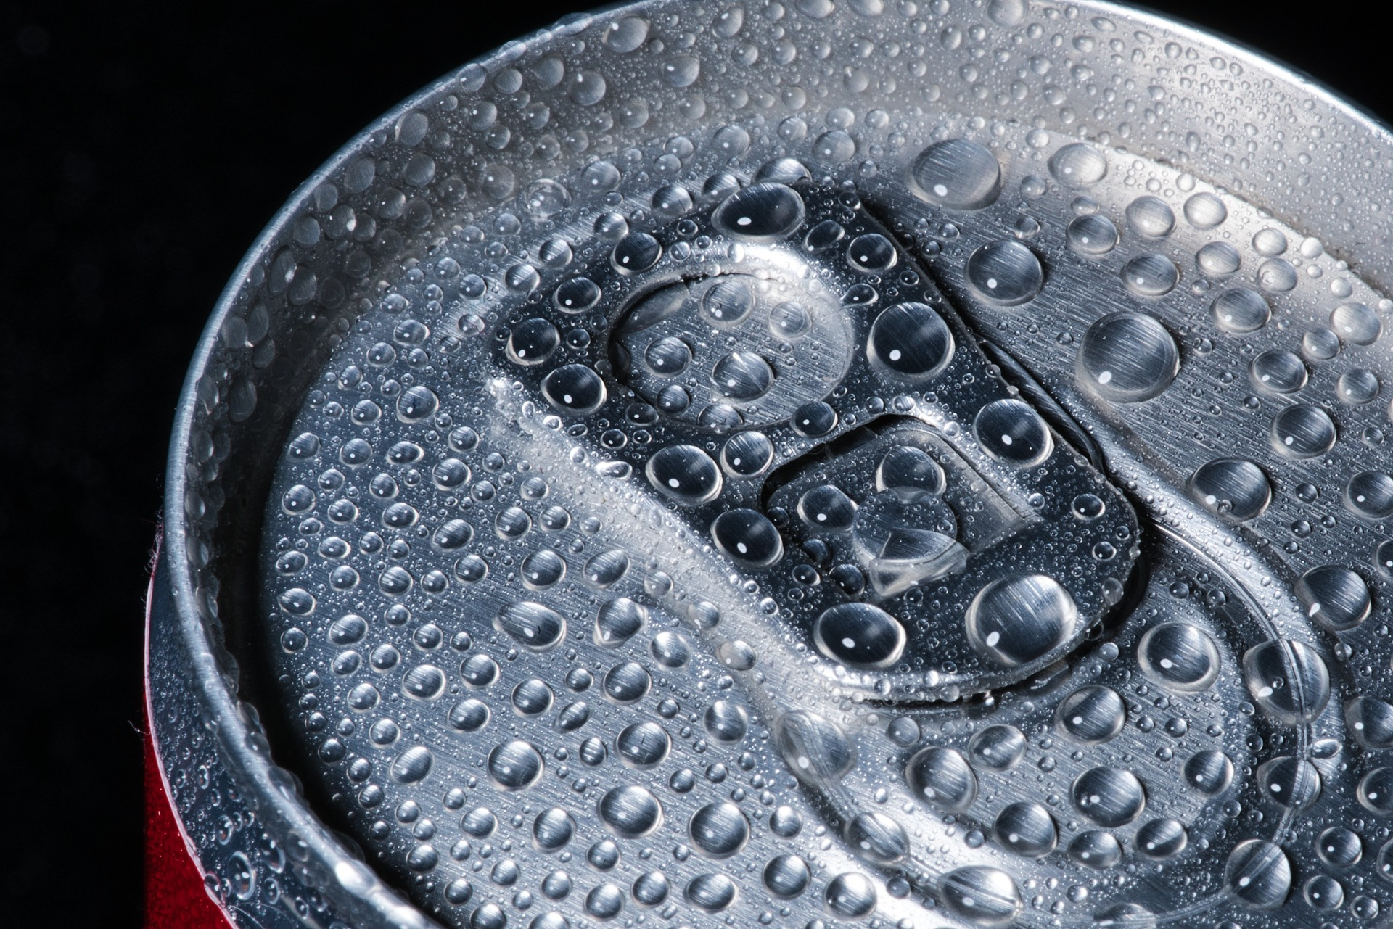
Aluminium
Aluminium is the 3rd most abundant element in the Earth’s crust, however it wasn’t discovered until the 1800’s.
Can you guess why?
Aluminium is never found as a pure metal, only in an ore.
Explain which method is used to extract aluminium from its ore.
Electrolysis is used to extract aluminium from its ore. This is because aluminium is more reactive than carbon, so it cannot be extracted by reduction with carbon.
Notes:
Exposition type: Explanation
Image source: Pixabay

Slide 12
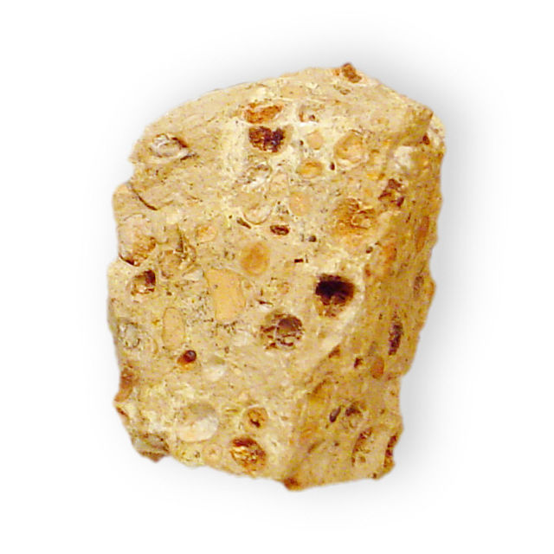
The extraction of aluminium
Aluminium ore is called bauxite.
1
Bauxite can be purified to produce aluminium oxide, Al₂O₃.
Aluminium metal can be obtained from aluminium oxide by electrolysis.
The ions in aluminium oxide need to be free to move for electrolysis.
It would be too expensive to melt the ore for electrolysis, because this would require a lot of energy.
Instead, the aluminium oxide is dissolved in cryolite, so that a solution is made that has a much lower melting point.
Carbon is used as the positive anode.
2
3
4
5
6
7

Slide 13

Each of these is a method used to extract metals from their ores. When is each method used and why?
Displacement with carbon
Electrolysis
Notes:
Suggested guidance:
Talk tasks can be used in a variety of ways to suit the particular needs of the students you are teaching. Through exchanging views with others, students develop their understanding of the science beyond what could be achieved individually.
Science classrooms that successfully integrate talk have the following features:
Science talk is a regular feature of lessons and is woven into classroom activities.
Students are paired or grouped strategically by the teacher to ensure productive interaction. This might take into consideration the students’ proficiency of the English language, how encouraging they might be to peers and their attainment in the topic. It’s a good idea to consider these pairings in the class seating plan.
Students are encouraged and supported to talk, but are not forced to talk.
The teacher should take on the role of a facilitator, engaging with conversations where necessary and encouraging or steering the conversation where needed.
Students are encouraged to use the language they have to express their ideas (e.g., everyday language, imperfect English, native language), but also to incorporate science specific terminology where this is more accurate or has been taught.
6. Scientifically inaccurate ideas are not dismissed by the partner or teacher; open discussion and further investigation are relied on to help students construct ideas that support them to progress in their scientific understanding.
7. Guidelines for behaviour during talk tasks are explicit and frequently reviewed. Rules for students might be:
Listen carefully to your partner
Take turns talking.
Speak one at a time, without interrupting.
Politely agree or disagree and explain why.
Politely point out if your partner has used a scientific word incorrectly, if they have explained the science incorrectly, or if there is a more accurate way to describe something.
If confused, ask questions.
Stay focused on the discussion topic.
Respond to one another.

Slide 14
Drill
What is aluminium ore called?
State the formula for aluminium oxide.
Which process is used to extract aluminium from aluminium oxide?
Why does an ore need to be molten for electrolysis to take place?
Why isn’t aluminium oxide melted for electrolysis to be carried out?
What is done for the ions in aluminium oxide to be able to move during electrolysis?
Why isn’t aluminium extracted from its ore by displacement reaction with carbon?
What method is used to extract copper from its ore?
What method is used to extract gold from its ore?
Why is electrolysis an expensive process?
Notes:
Purpose: This is a knowledge drill. The purpose of this is to check that the critical knowledge is secure before pupils move onto independent practice.
Suggested guidance: There are a range of ways this could be done depending on time and ability range of the class:
Mini whiteboards
As full sentences in exercise books
As short answers in exercise books
In the pupil workbook
As pair talk
As cold call

Slide 15
Drill answers
Aluminium ore is called bauxite
The formula for aluminium oxide is Al₂O₃
Electrolysis is used to extract aluminium from aluminium oxide
So that the ions are free to move.
Aluminium oxide isn’t melted for electrolysis to take place because this requires a lot of energy and so is expensive.
The ore is dissolved in cryolite so that the melting point of the mixture is lower, and less heating is needed to melt aluminium oxide.
The aluminium isn’t extracted by displacement reaction with carbon, because aluminium is more reactive than carbon. Therefore this reaction wouldn’t occur.
Copper is extracted from its ore by displacement reaction with carbon.
Gold does not need to be extracted from an ore because it’s so unreactive it is found as a pure metal.
Electrolysis is an expensive process because it requires a lot of energy to produce the electricity needed.
Notes:
Purpose: This is a knowledge drill. The purpose of this is to check that the critical knowledge is secure before pupils move onto independent practice.
Suggested guidance: There are a range of ways this could be done depending on time and ability range of the class:
Mini whiteboards
As full sentences in exercise books
As short answers in exercise books
In the pupil workbook
As pair talk
As cold call

Slide 16

I: Explain: to use scientific understanding to make something clear or state the reason for something happening
Example question:
To ‘explain’ your answer should:
Begin with a scientific statement.
Use ‘this means that’, ‘because’ or ‘so’ to link your statement to the question.
Explain why aluminium is extracted using electrolysis.
Model answer:
Aluminium has to be extracted using electrolysis because it is more reactive than carbon
This means that it cannot be extracted by displacement with carbon
Notes:
This slide models the process of answering an explain question.
Firstly, students are presented with a generic explain question, along with a model answer. Students are also given some simple guidance to follow for producing their own describe answer.
The generic question and answer should be used by the teacher to remind students of
the key features of a great answer
how to structure their answer
why the model answer is a good example
Following this, students will be required to apply this process to answer their own explain question, which will appear in place of the generic questions. This explain question will be specific to the topic students are learning about in the lesson. Give students time to write their own answer to this, ensuring that they use the guidance provided. To further scaffold this task for students, it may be appropriate to:
pair students up to write an answer together
list for students the key words you would like them to include in the answer
provide a writing frame or ‘points to include’ for students
A model answer for this question will appear. Teachers should review the model answer with students by referencing the guidance in the green box. For example ‘we can see item 1 in the guidance is to begin with a scientific statement. Notice in the model answer here we have done just that’. Or ‘item 2 in the guidance here says that we should use a linking statement in the answer. Has this been achieved in the model answer? Where can we see this?’.

Slide 17
We: Explain: to use scientific understanding to make something clear or state the reason for something happening
Example question:
To ‘explain’ your answer should:
Begin with a scientific statement.
Use ‘this means that’, ‘because’ or ‘so’ to link your statement to the question.
Explain why aluminium is not extracted using displacement with carbon.
Model answer:
Aluminium has to be extracted using electrolysis because it is more reactive than carbon
This means that it cannot be extracted by displacement with carbon
Notes:
This slide models the process of answering an explain question.
Firstly, students are presented with a generic explain question, along with a model answer. Students are also given some simple guidance to follow for producing their own describe answer.
The generic question and answer should be used by the teacher to remind students of
the key features of a great answer
how to structure their answer
why the model answer is a good example
Following this, students will be required to apply this process to answer their own explain question, which will appear in place of the generic questions. This explain question will be specific to the topic students are learning about in the lesson. Give students time to write their own answer to this, ensuring that they use the guidance provided. To further scaffold this task for students, it may be appropriate to:
pair students up to write an answer together
list for students the key words you would like them to include in the answer
provide a writing frame or ‘points to include’ for students
A model answer for this question will appear. Teachers should review the model answer with students by referencing the guidance in the green box. For example ‘we can see item 1 in the guidance is to begin with a scientific statement. Notice in the model answer here we have done just that’. Or ‘item 2 in the guidance here says that we should use a linking statement in the answer. Has this been achieved in the model answer? Where can we see this?’.

Slide 18
You: Explain: to use scientific understanding to make something clear or state the reason for something happening
Example question:
To ‘explain’ your answer should:
Begin with a scientific statement.
Use ‘this means that’, ‘because’ or ‘so’ to link your statement to the question.
Explain why aluminium oxide is dissolved in cryolite for electrolysis.
Model answer:
Ions need to be free to move during electrolysis
This means that aluminium oxide needs to be molten or in solution
It is dissolved in cryolite so that the mixture has a lower melting point, so this would require less energy to melt and would be less expensive
Notes:
This slide models the process of answering an explain question.
Firstly, students are presented with a generic explain question, along with a model answer. Students are also given some simple guidance to follow for producing their own describe answer.
The generic question and answer should be used by the teacher to remind students of
the key features of a great answer
how to structure their answer
why the model answer is a good example
Following this, students will be required to apply this process to answer their own explain question, which will appear in place of the generic questions. This explain question will be specific to the topic students are learning about in the lesson. Give students time to write their own answer to this, ensuring that they use the guidance provided. To further scaffold this task for students, it may be appropriate to:
pair students up to write an answer together
list for students the key words you would like them to include in the answer
provide a writing frame or ‘points to include’ for students
A model answer for this question will appear. Teachers should review the model answer with students by referencing the guidance in the green box. For example ‘we can see item 1 in the guidance is to begin with a scientific statement. Notice in the model answer here we have done just that’. Or ‘item 2 in the guidance here says that we should use a linking statement in the answer. Has this been achieved in the model answer? Where can we see this?’.

Slide 19
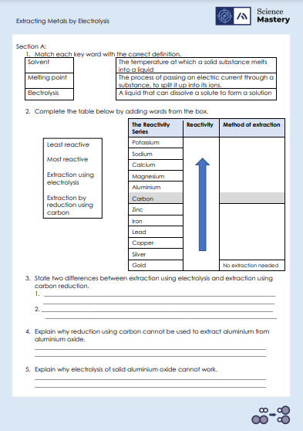
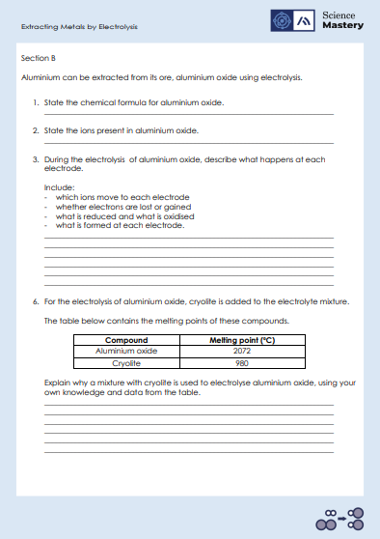
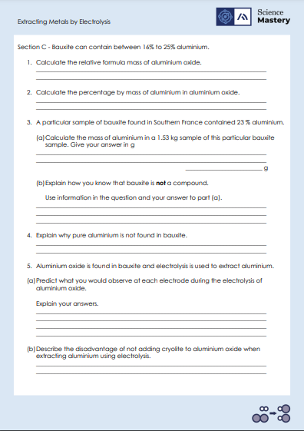
Activity

Slide 20
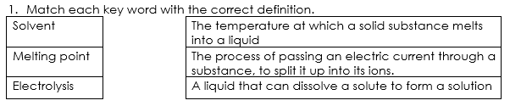
Answers – Section A

Slide 21
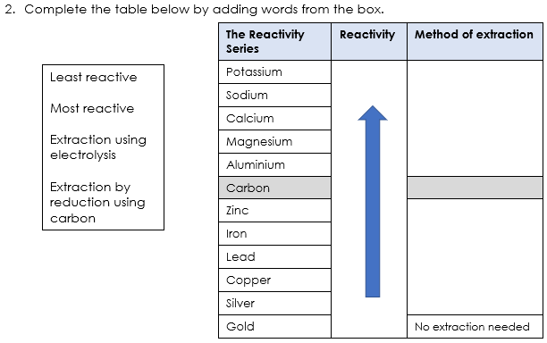
Answers – Section A
Most reactive
Extraction using electrolysis
Extraction by reduction using carbon
Least reactive

Slide 22
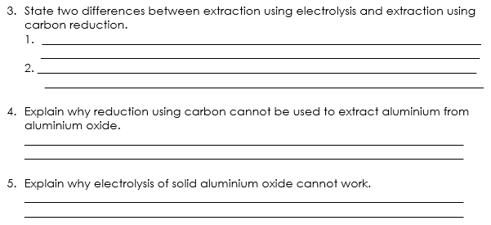
Answers – Section A
Electrolysis requires electricity whereas carbon reduction does not.
The metal compound must be liquid for extraction by electrolysis, but liquids aren’t required for carbon reduction
Carbon is less reactive than aluminium so it cannot be used in a displacement reaction to extract it.
Electrolytes must be liquid so that the ions are free to move and conduct electricity
Notes:
Alternative correct answers:
Q3. Electrolysis can extract metals more reactive than carbon, but extraction using carbon reduction cannot.

Slide 23
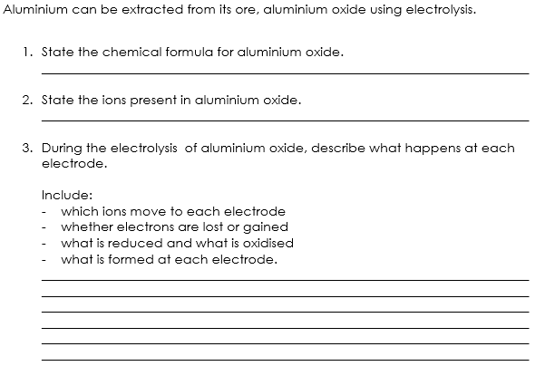
Answers – Section B
Al₂O₃
Al³⁺ O²⁻
Al³⁺ is positively charged so moves towards negative electrode (cathode)
O²⁻ is negatively charged so moves towards positive electrode (anode)
Al³⁺ gains 3 electrons, so is reduced and forms aluminium atoms
O²⁻ loses 2 electrons, so is oxidised and forms oxygen atoms
Notes:
Alternative correct answers:
Q3. Solid, silver metal is produced at the cathode and bubbles of transparent gas are produced at the anode.

Slide 24
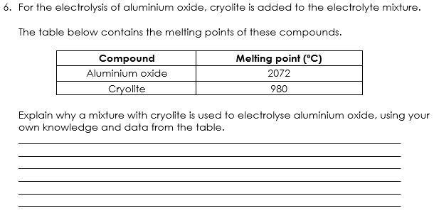
Answers – Section B
During electrolysis, aluminium oxide must be liquid because the ions need to be free to move.
The melting point of aluminium oxide is 2072⁰C which requires a lot of expensive energy to melt it.
The melting point of the solvent cryolite is much lower at 980⁰C, so it is used to dissolve aluminium oxide at a much lower temperature, therefore saving energy and making the process cheaper.

Slide 25
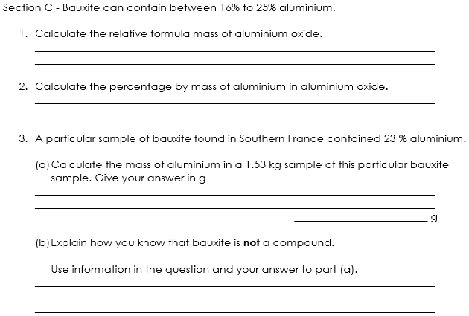
Answers – Section C
Aluminium: 27
Al₂O₃: (27 x 2) + (16 x 3)
54 + 48 = 102
Oxygen: 16
54 x 100 = 53%
102
1.53 x 1000 = 1530 g 1530 x 23 = 351.9 g
100
Bauxite can contain a varying amount of aluminium, between 16-25%, however compounds have fixed proportions of elements and do not vary.
Notes:
Suggested guidance: working through these with the class at the white board whilst questioning about each part of the calculations will support students who are struggling with these different types of calculations.
Suggested guidance: Q2 has been rounded to the nearest whole number but decimal values are acceptable too.

Slide 26
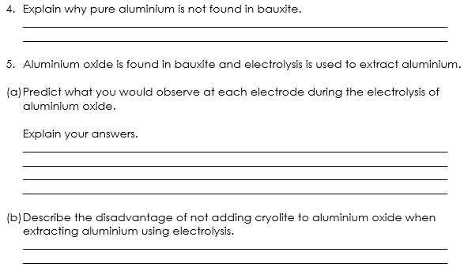
Answers – Section C
Aluminium is too reactive to be found as pure elemental aluminium. Instead, it is found in ores as aluminium oxide.
At the cathode you would see silver, solid metal being produced because Al³⁺ ions have been reduced to form Al atoms.
At the anode you would bubbles of transparent gas being produced because O²⁻ ions have been oxidised to form O₂ molecules.
It would be more expensive because more energy is needed to melt aluminium oxide which has a much higher melting point than cryolite.

Slide 27
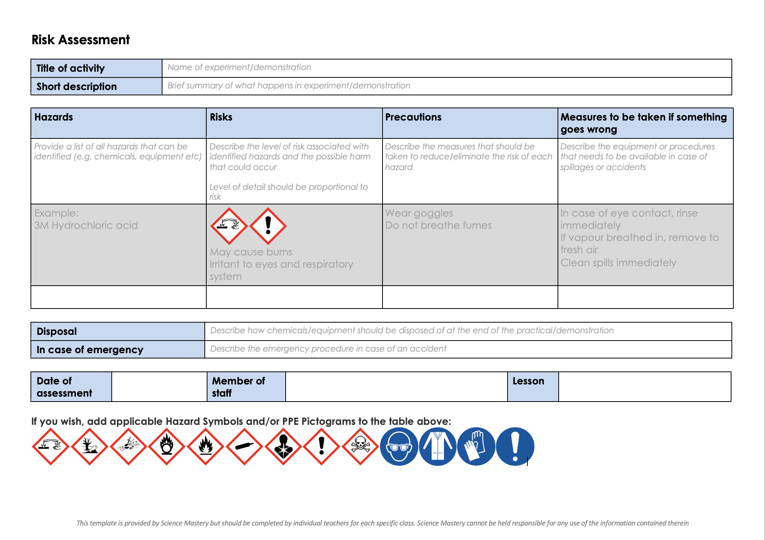
Risk Assessment
A risk assessment must be completed for this practical
The template risk assessment can be found here.

Slide 28
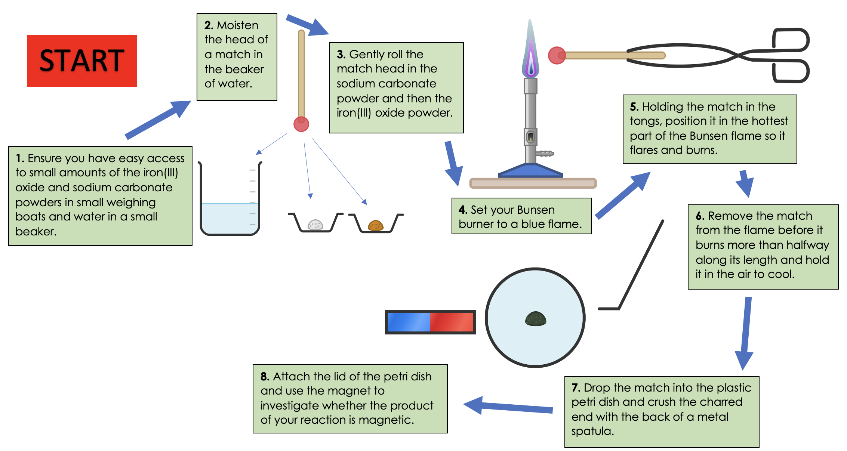
Class practical: Extraction of metal from a match head
Notes:
Please see the practical guide included with this practical.

Slide 29
Answer the questions below.
Aluminium is extracted by electrolysis.
Which answer best describes why aluminium cannot be extracted from its ore by heating aluminium oxide with carbon?
A. because aluminium is less reactive than hydrogen
B. because aluminium is more reactive than carbon
C. because aluminium is too reactive
✓
2. Why don't we usually carry out electrolysis on molten aluminium ore?
A. It is expensive to heat the ore to a high enough temperature to melt it.
B. Electrolysis can be carried out on solid aluminium ore.
C. It is too expensive to dissolve the aluminium ore in molten cryolite
✓
Notes:
Q1. Answer: B
If students answer A or C, they have either not consulted the reactivity series, or have misinterpreted it to think that aluminium is less reactive than hydrogen. They may also have the misconception that reactive metals cannot be extracted. To fix-it, use the reactivity series to recap the different methods of extraction of metals, and when each one is suitable, by referring to their relative reactivities compared to hydrogen and carbon.
Q2. Answer: A
If students answer B, they have the misconception that electrolysis can be carried out with a solid electrolyte. To fix-it, use a diagram of an ionic lattice or solid particle diagram to explain why solid ionic substances or solid aluminium ore cannot conduct electricity.
If students answer C, they have grasped that carrying out electrolysis on molten aluminium ore is expensive, but they have not understood why this is so. To fix it, point out that dissolving is not an expensive process, but the energy required to heat an ore to melt it is expensive.

Slide 30
Lesson C4.2.8
What was good about this lesson? | What can we do to improve this lesson?
Send us your feedback by clicking this link
or by emailing sciencemastery@arkonline.org
Thank you!

